Slide 1
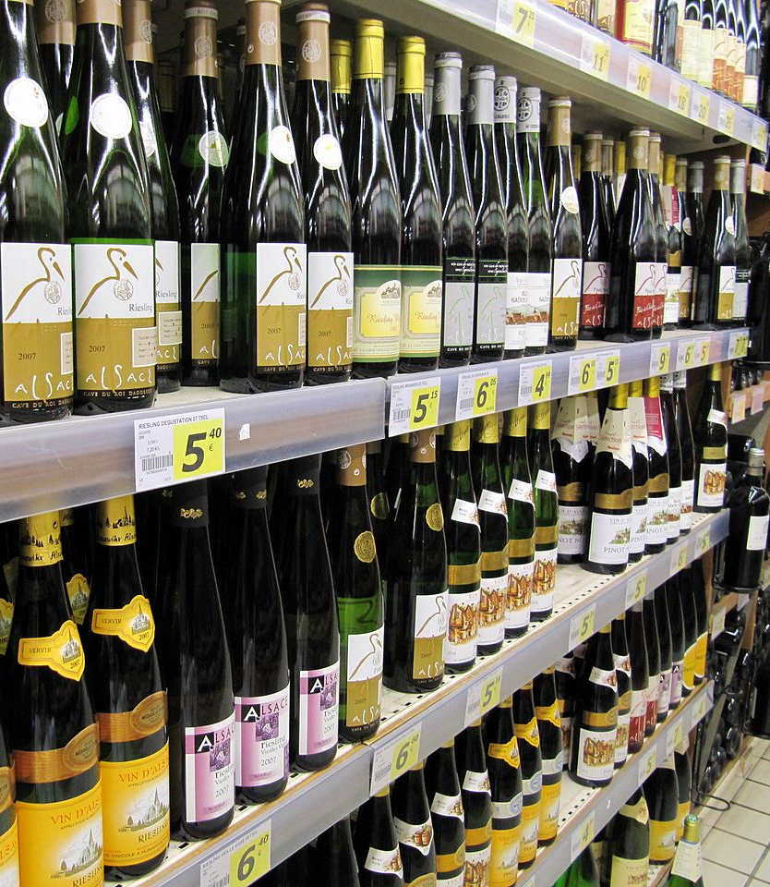
Competitive Analysis
What the Wine

Slide 2

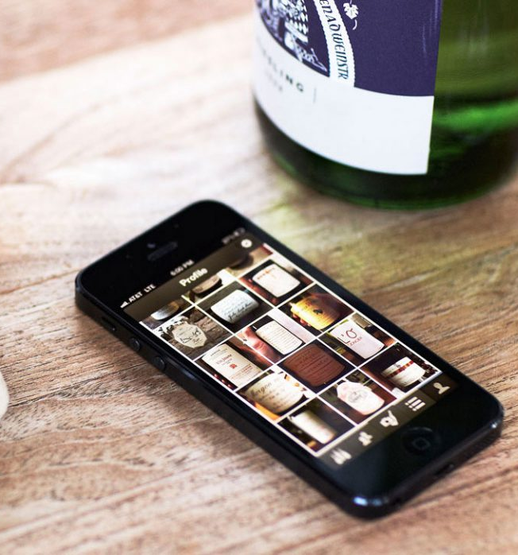
Delectable App
It contains a catalogue of different wines and allows users search for wines or scan the picture of a bottle of wine
Wine can be purchased on the app
It’s regarded as ‘the Instagram for wine’ as it allows people see what other wine lovers and wine makers are drinking, other people’s ratings of different wines. It also allows people follow and connect with wine makers, wine writers etc

Slide 3
Strength and Weakness
Strengths
It contains a catalogue of wines users can choose from with details such as reviews and ratings of wine lovers and wine makers
It allows users select and purchase wine from the comfort of their home and get it delivered to their doorstep
Weakness
Its aim is not to help users select the right wine to purchase when grocery shopping on their own by providing information such as taste, age, food pairing etc.

Slide 4
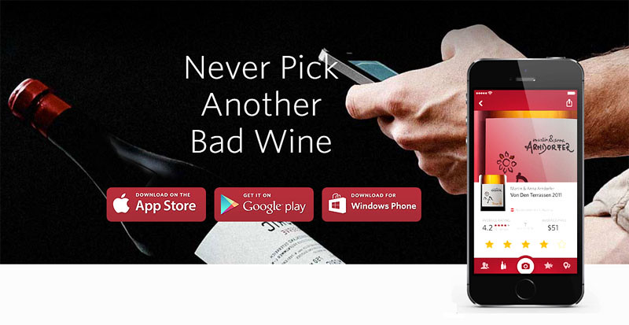
Vivino App
It is known as the largest wine marketplace with 11.9 million wines and 220,000 wineries
Support team to help users with issues
It provides information such as taste, food pairings, reviews , stores or restaurants to buy them etc

Slide 5
Strength and Weakness
Strengths
It offers discounted prices and free delivery with certain amount of purchase
It allows users compare and find wines similar to the ones they love
Weakness
Ratings may be skewed by commercial interest

Slide 6

Wine Searcher
It allows users search for wines, beers and spirits across online stores
It provides latest news and updates on wines from different parts of the world
Budget friendly wine selection with prices from 1€

Slide 7
Strength and Weakness
Strengths
Budget friendly
Daily articles and news about wines
Weakness
Wines found on the app might not be available in merchant‘s online store

Slide 8
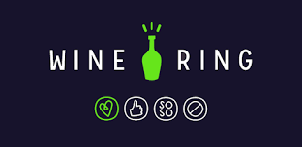
Wine Ring App
It builds your preference profile when you take pictures of the wines you have tasted and rate them “love, like, so-so, dislike”.
Users don’t have to enter too much information; they just scan the wine at the supermarket and the app will tell them if they’ll like it based on their past preference
It allows users keep a journal of all the wines they have tasted and their ratings

Slide 9
Strength and Weakness
Strengths
It is tailored to satisfy individual preferences
The app is easy to use
Weakness
Limited catalogue of wines hence it doesn‘t identify many wines scanned by users
Users need to enter and rate a lot of wines before the app can identify their preference

Slide 10
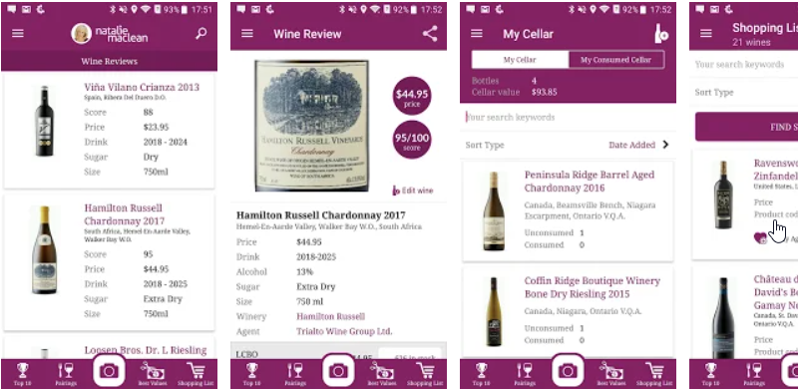
Wine Scanner & Expert Reviews
The center is the search for wine with fitting food or occasion
You don’t search with words, just with the camera (frontlabel or barcode)
https://play.google.com/store/apps/details?id=com.nataliemaclean.natdecants

Slide 11
Strength and Weakness
Strengths
It has search options for occasion or fitting food
Good looking app
It has not only a barcode search, you can search labels too
Weakness
For full features you have to register
The search option „Occasion“ shows empty results

Slide 12
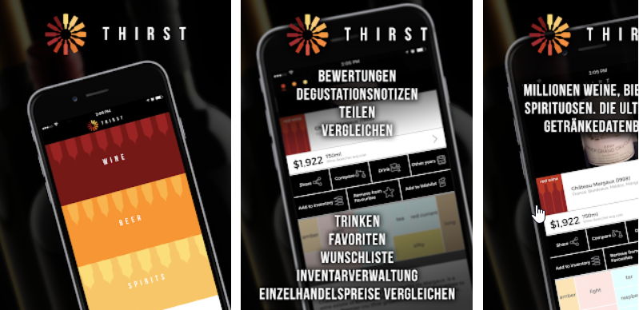
Thirst - Wein, Bier, Spirituosen
When you register you have many options you can use like your favorite wines, what wines you last searched, your wishlist, etc.
Without registration you also have the most important features like searching for wines, etc.
You can add friends with similar wine taste (just with registration)
https://play.google.com/store/apps/details?id=com.thirst

Slide 13
Strength and Weakness
Strengths
You can use the App even without registration (but just with limited functions)
Not only wine, even beer and spirits are search- and rateable
Weakness
No search through topics like fitting food, etc. just countries and regions (and Barcodes)
You have to make a lot of clicks to get the final page of the wine
Because of so many features it feels a little bit clunky

Slide 14

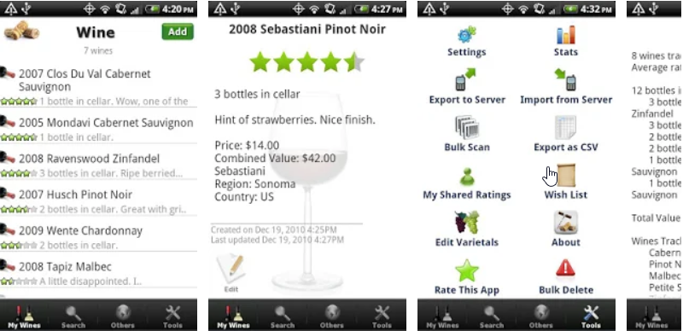
Wine - List, Ratings & Cellar
Free: https://play.google.com/store/apps/details?id=com.metosphere.winefree&hl=de&gl=US Paid:
https://play.google.com/store/apps/details?id=com.metosphere.wine&hl=de&gl=US
You can create your personal wine collections and make wishlists
The user can search through words or barcode
Without paid Pro Version you have to live with annoying ads

Slide 15

Wine - List, Ratings & Cellar
Strengths
Lightweight and easy to understand
The app is easy to use
Import/Export option of your wines (CSV)
Weakness
For the in my eyes usable version you have to pay 3,99 €
In my eyes a too technical approach, there is no (wine) soul

